Slide 1
Discussion Section (Week 1)
CSCI 561 - Foundation for Artificial Intelligence
Prof Wei-min shen wmshen@usc.edu

Slide 2
Outline
Introduction of myself
Overview of Course Discussion
History (Success) of Artificial Intelligence
Agents and Environments
Evaluation Criteria of AI
Applications of AI
What You Should Know This Week

Slide 3
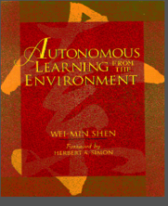

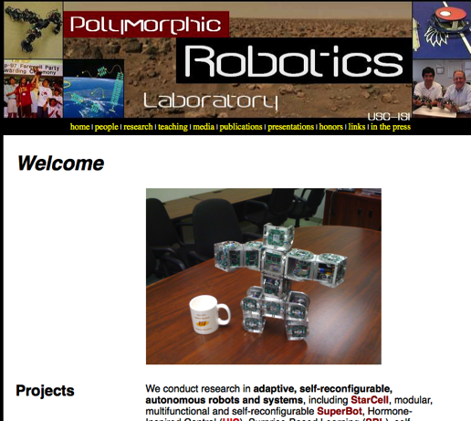
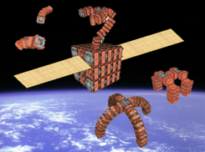
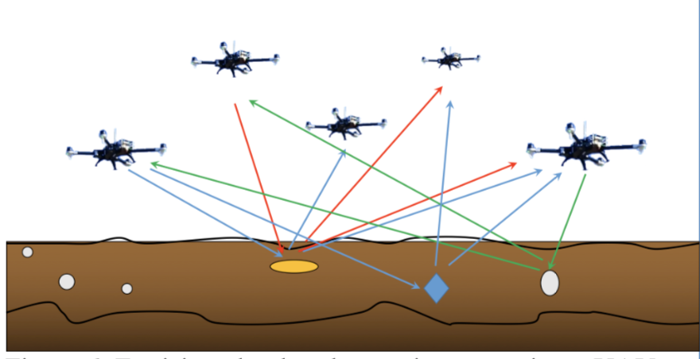
USC Polymorphic Robotics Lab http://www.isi.edu/robots
Transformer Robots: Self-Reconfigurable & Modular
Surprise-Based Learning
Teaching
CS561 (AI)
CS360 (AI)
INF552
INF553

Slide 4
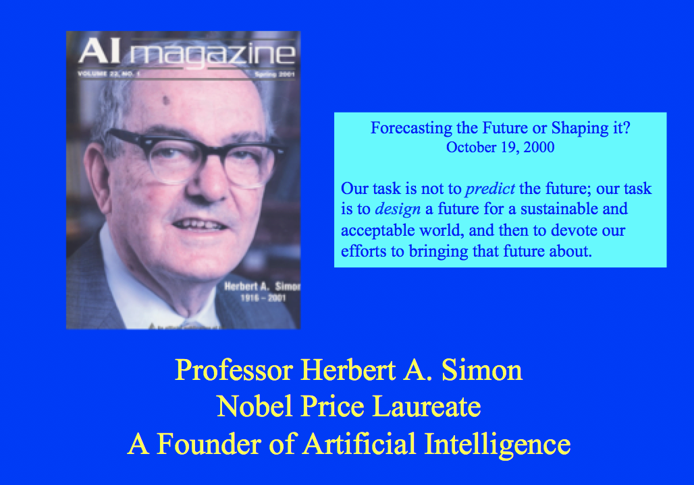
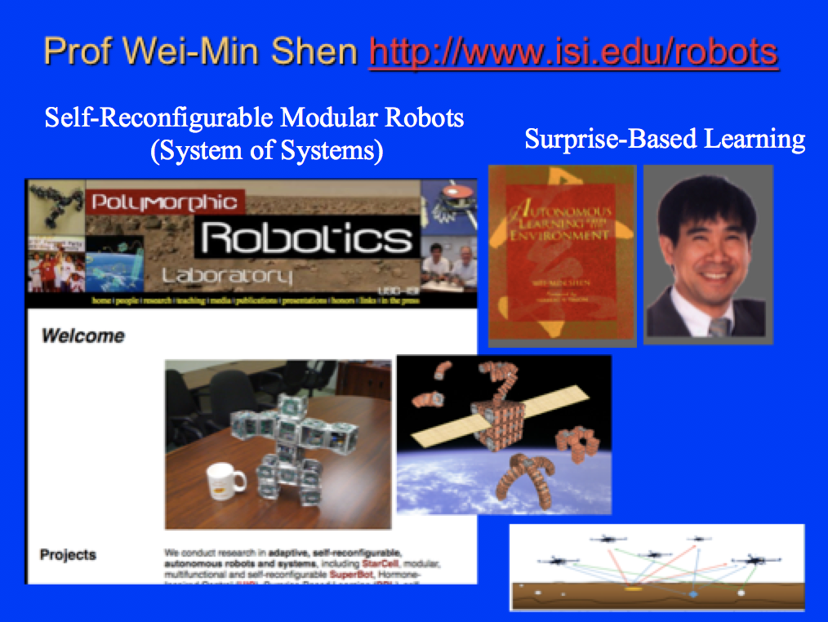
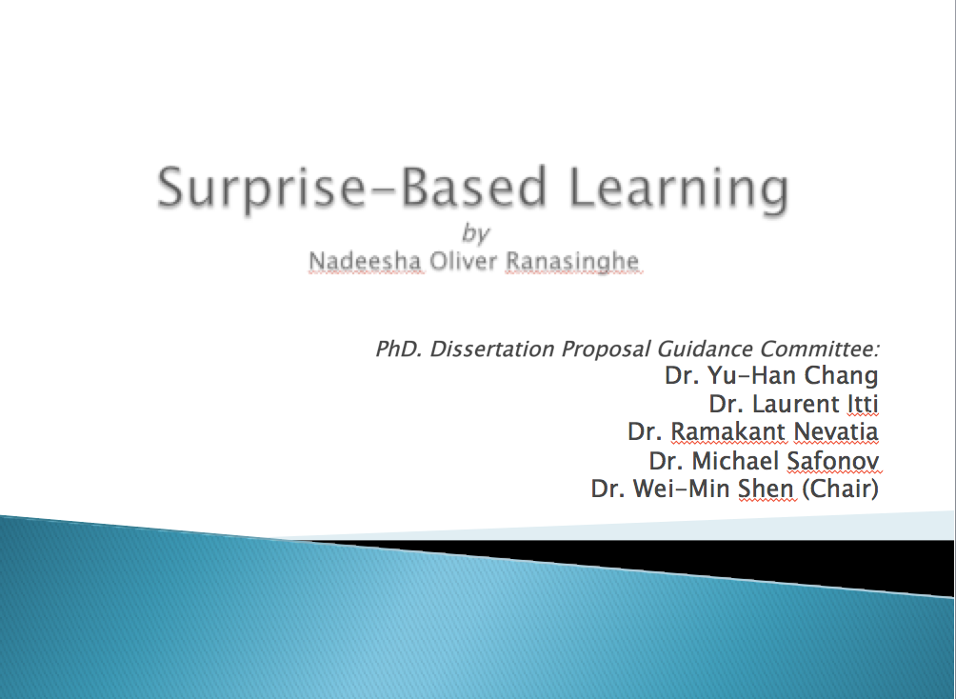
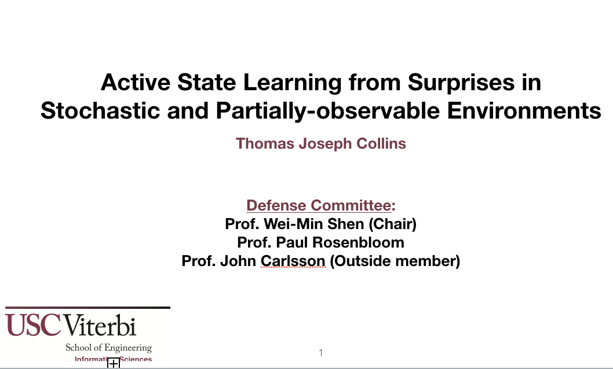
Surprise-Based Learning
Herbert A. Simon (1916-2001)
Nobel Price Winner (AI, Machine Discovery)
Wei-Min Shen (1983 – now)
Autonomous Learning from the Environment
Nadeesha Ranasinghe (2005 – now)
Learn and predict unexpected changes
Thomas J. Collins (2013 – now)
Discovery of hidden/latent structures

Slide 5
CS561: Artificial Intelligence
Course overview: foundations of symbolic intelligent systems. Agents, search, problem solving, logic, representation, reasoning, symbolic programming, and robotics.
Prerequisites: Good programming and algorithm analysis skills. Basic probability theory desirable.
Textbook:
Russell & Norvig, Artificial Intelligence: A Modern Approach 3rd Edition
Wei-Min Shen, Autonomous Learning from the Environment, (selected readings).

Slide 6
CS561: Artificial Intelligence
Discussion Sections
Provide more details, discussion and new material to augment lectures
Run algorithms on more complex examples than during lectures
Relate lecture concepts to latest research topics
Showcase cool demos of recent A.I. achievements
NOTE:
You will be responsible for material presented in lecture and discussion sections

Slide 7
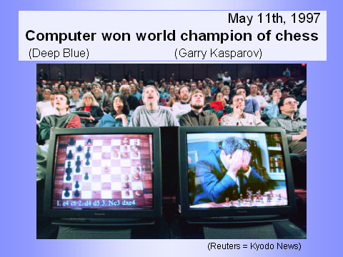
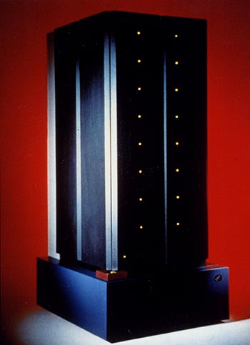

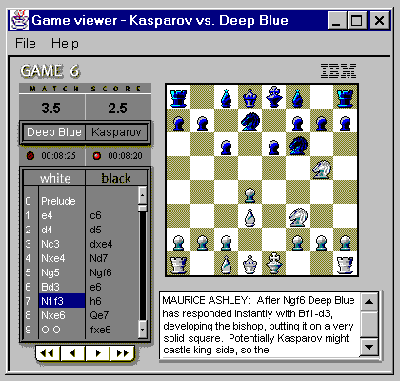
AI success: Deep Blue
In 1997 Deep Blue became the first machine to win a match against a reigning world chess champion (by 3.5-2.5)

Slide 8
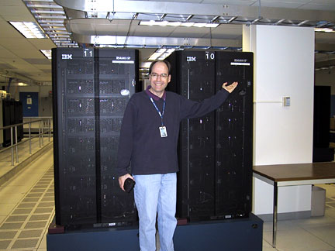
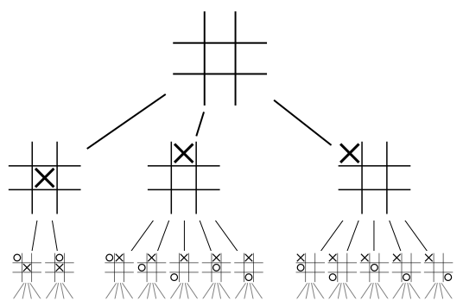
Deep Blue Combined
Parallel and special purpose hardware
A 30-node IBM RS/6000, enhanced with
480 special purpose VLSI chess chips
A heuristic game-tree search algorithm
Capable of searching 200M positions/sec
Searched 6-12 moves deep on average, sometimes to 40
Chess knowledge
An opening book of 4K positions and 700K GM games
An endgame database for when only 5-6 pieces left
A positional evaluation function with 8K parts and many parameters that were tuned by learning over thousands of Master games
Notes:
What are PEAS or PAGE for Deep Blue?

Slide 9

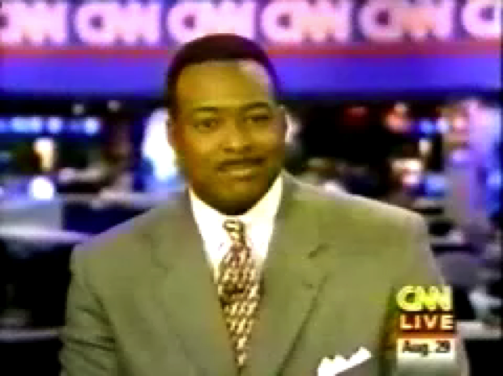
First RoboCup (1997)
Notes:
USC Team first world Champions in robot soccer. Challenge to beat human champions by 2050. Video of first Sony Aibo

Slide 10
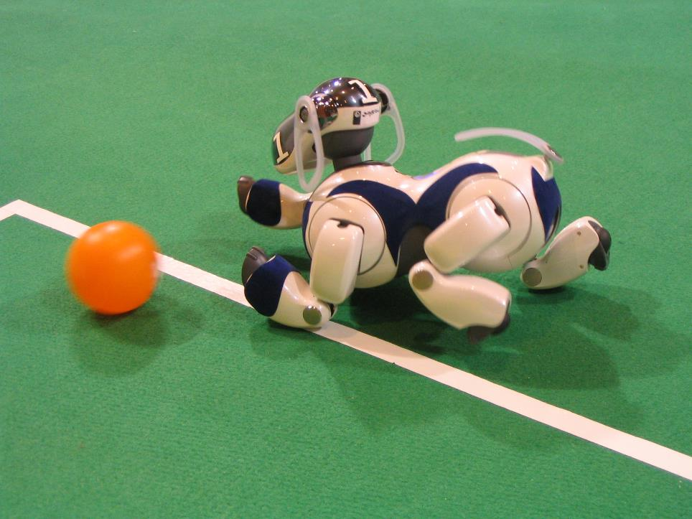
Sony Aibo Robot Dog League
Notes:
Goals?
Percepts?
Sensors?
Effectors?
Actions?
Environment?

Slide 11
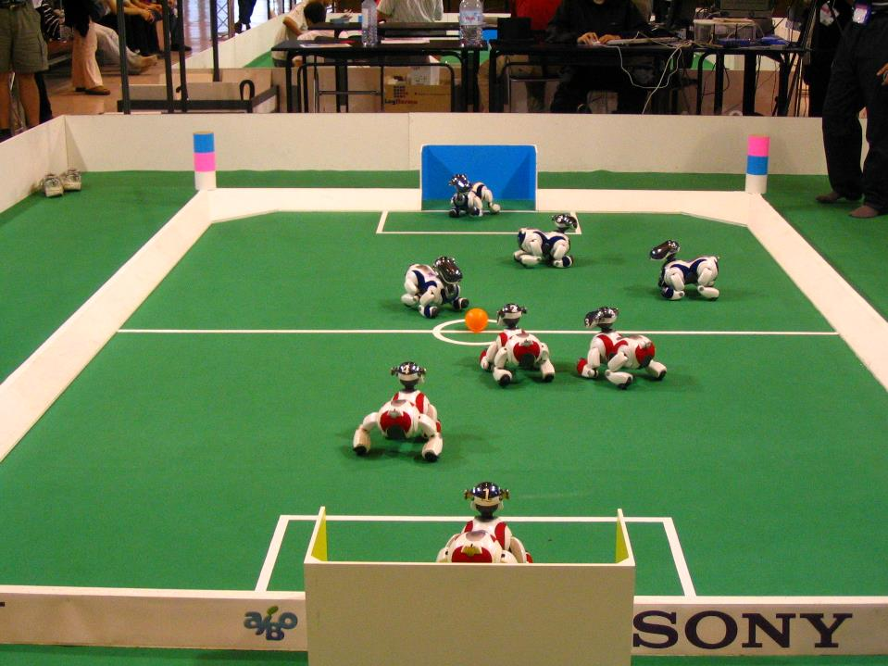

Slide 12
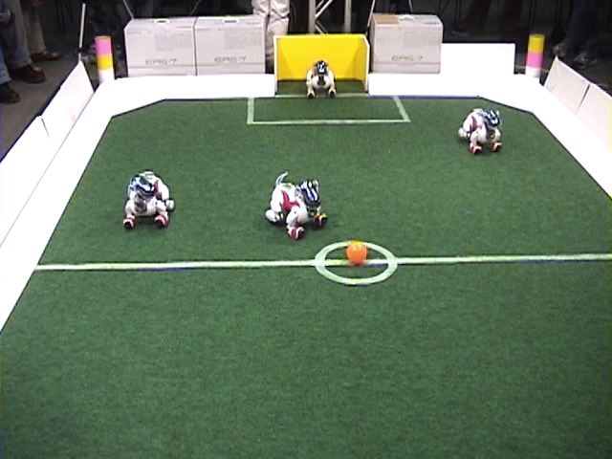
Notes:
Autonomous
On-board sensing, thinking, and acting
Efficient
Function under time and resource constraints in dynamic environment
Intelligent
Vision, reasoning, planning, and learning
Teamwork:
Coordinate with other players to accomplish goals

Slide 13
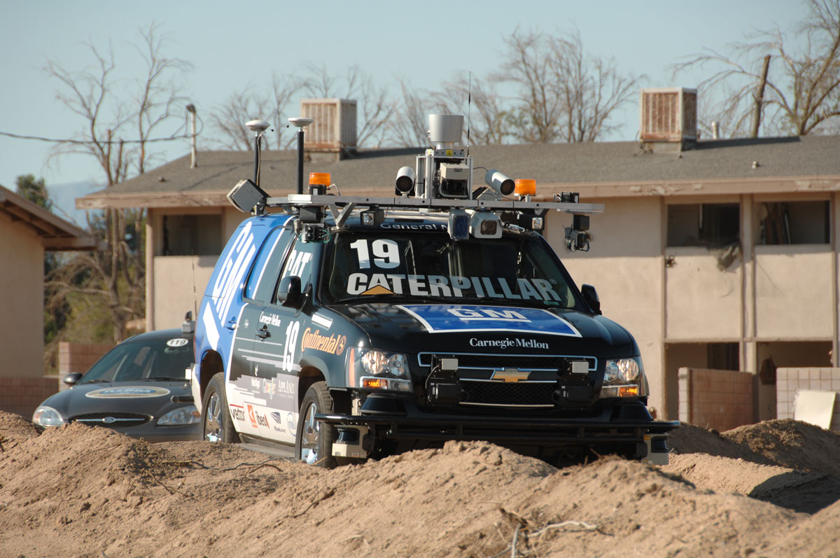
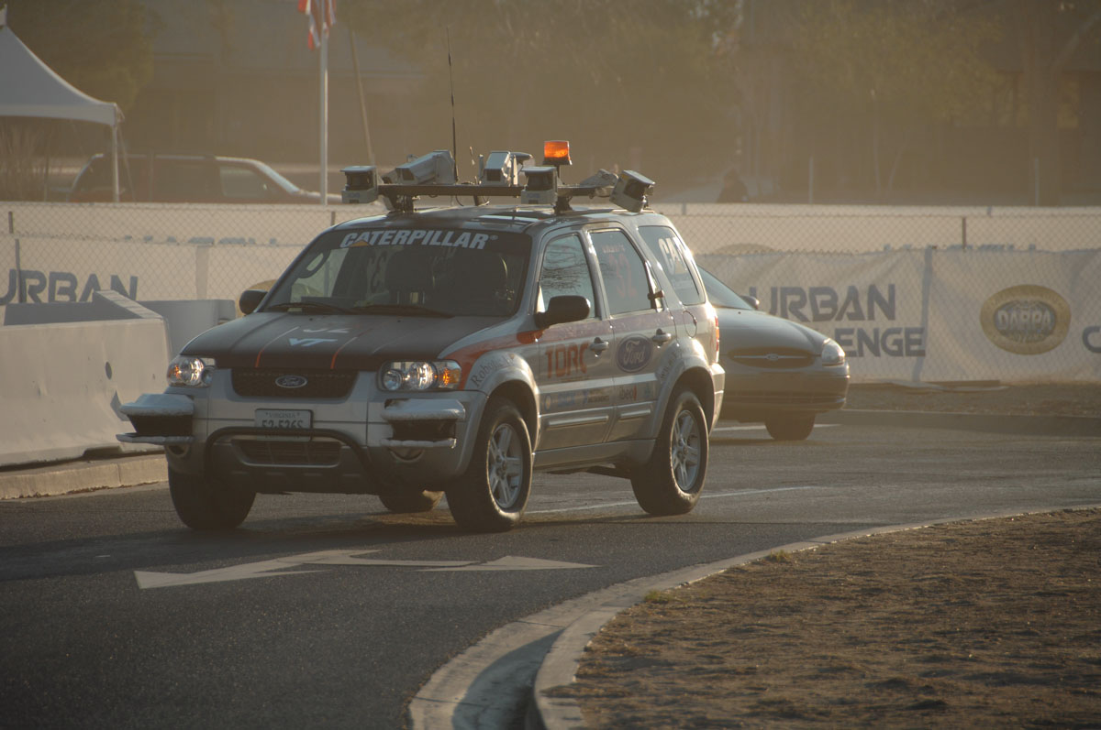
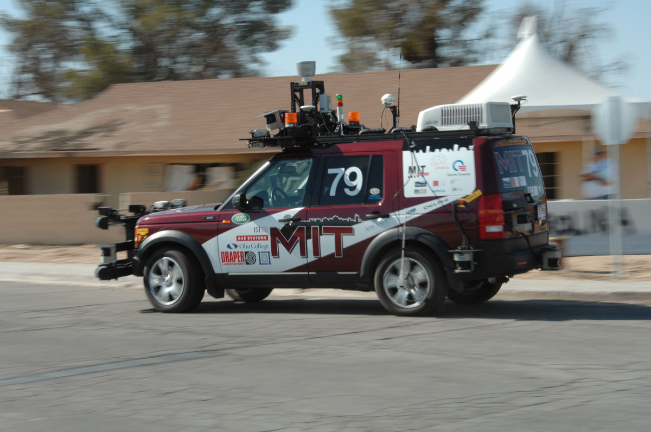
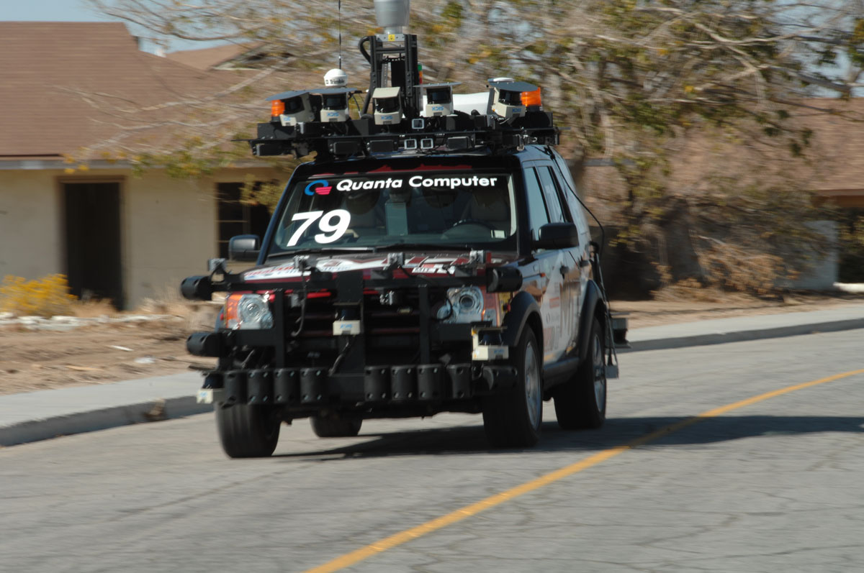
DARPA Urban Challenge (2007)
“Autonomous vehicles that safely execute missions in a complex urban environment with moving traffic.”
“The objective of this program is safe and correct autonomous driving capability in traffic at 20 mph.”

Slide 14
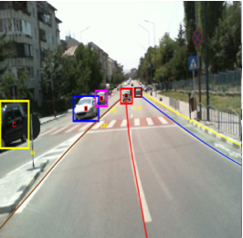
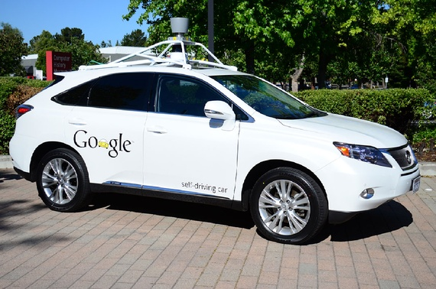
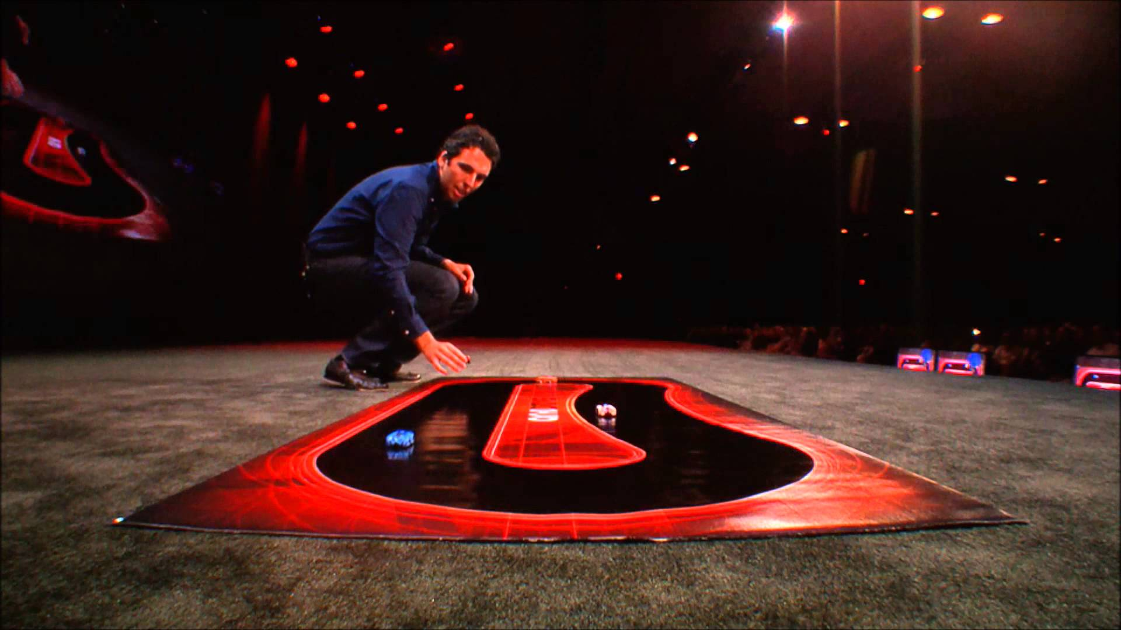
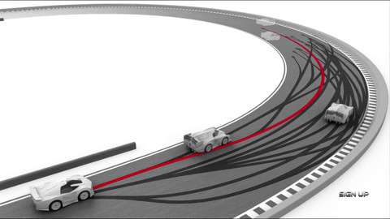
Self-Driving Car
ANKI Drive

Slide 15

DARPA Grand Challenge for Robotics

Slide 16
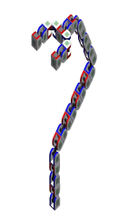
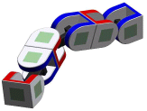
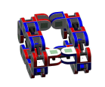
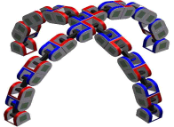

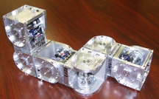
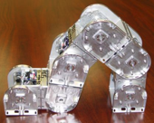
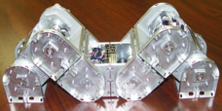

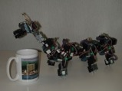
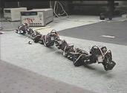
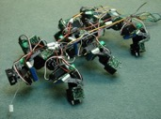
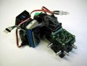

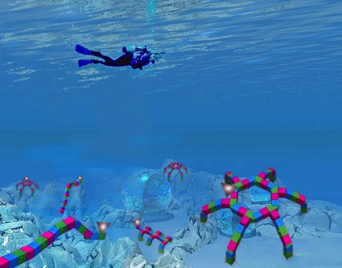



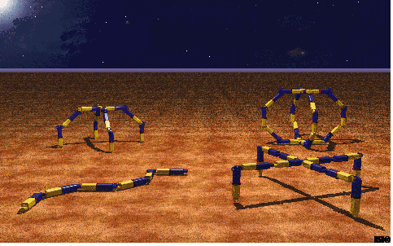
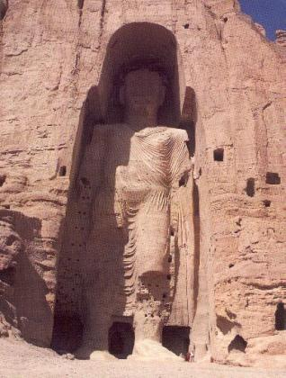
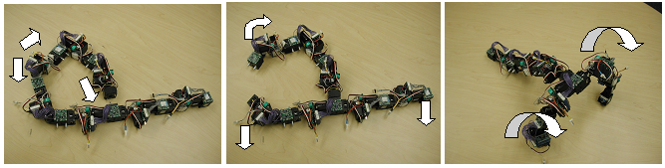
USC Self-Reconfigurable SuperBot

Slide 17
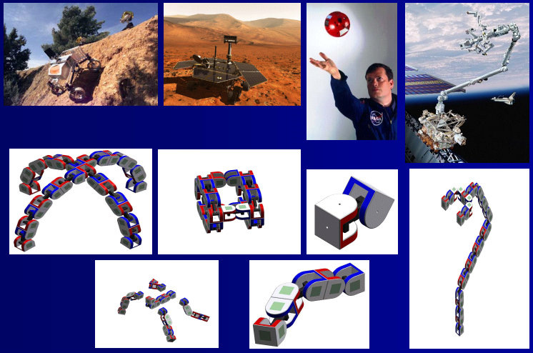
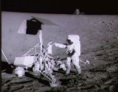

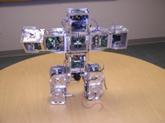
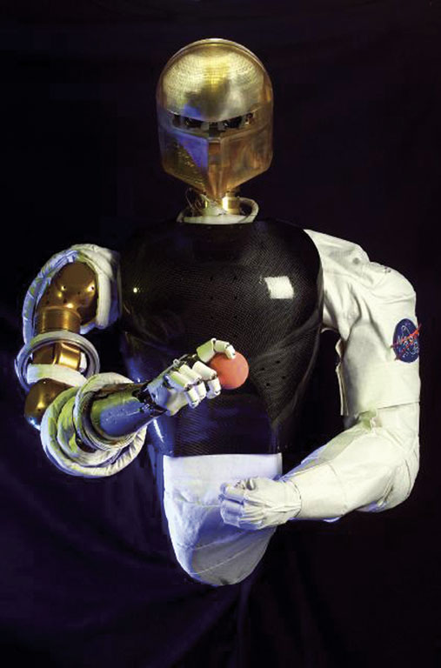
SuperBot Vision for Space Modular, Multifunction, Self-Reconfiguration

Slide 18

USC Self-Reconfigurable “SuperBot”

Slide 19
Agent Environment interactions
How to design this?
Sensors
percepts
Environment
AI?
Agent
actions
Effectors

Slide 20
Please consider
How to test if a system is “intelligent” or not?
What is a (basic) Turing test?
What is a (full) Total Turing test?
What is rational?
What is the most simple environment?
What is the most complex environment?
How many types of Agents?
What is an agent function? (optional 2 views)

Slide 21
What is AI?
The exciting new effort to make computers thinks … machine with minds, in the full and literal sense”
(Haugeland 1985)
“The study of mental faculties through the use of computational models”
(Charniak et al. 1985)
“The art of creating machines that perform functions that require intelligence when performed by people” (Kurzweil, 1990)
A field of study that seeks to explain and emulate intelligent behavior in terms of computational processes” (Schalkol, 1990)
How to Measure Intelligence?
Systems that think like humans
Systems that think rationally
Systems that act like humans
Systems that act rationally
Notes:
Which category is Deep Blue? Robot Soccer? Ada and Grace? Watson? Google Cars? Computer vision?

Slide 22

Eugene Goostman – Turing Test 2014
Interview
What do you think? Was the test really passed?
What effect did context, that is, saying that the computer was playing a 13-year-old Ukranian boy for whom English was a second language, have on the results?
What does that tell us about the Turing test as a test of artificial intelligence?
What would be a better test?
http://www.princetonai.com/bot/

Slide 23

Mitsuku – 2013 Loebener Winner
http://www.loebner.net/Prizef/loebner-prize.htm
Notes:
http://www.loebner.net/Prizef/loebner-prize.html

Slide 24
Major issues for AI Applications
How to represent knowledge about the world?
How to react to new perceived events?
How to integrate new percepts to past experience?
How to understand the user?
How to optimize balance between user goals & environment constraints?
How to use reasoning to decide on the best course of action?
How to communicate back with the user?
How to plan ahead?
How to learn from experience?
Notes:
Major Issues for AI systems we will discuss throughout the semester

Slide 25
Is AI science or engineering?
A science is a field of study that leads to the acquisition of empirical knowledge by the scientific method, which involves falsifiable hypotheses about what is.
A pure engineering field can be thought of as taking a fixed base of empirical knowledge and using it to solve problems of interest to society.
What are examples of AI systems that support your answer to this question?
Notes:
the “human” side of AI is clearly an empirical science— find out how human cognition actually works.
If we view it as studying the abstract relationship among an arbitrary task environment, a computing device, and the program for that computing device that yields the best performance in the task environment, then the rational side of AI is really mathematics and engineering;
In practice, however, we are interested in task environments that do approximate the actual world, so even the rational side of AI involves finding out what the actual world is like. For example, in studying rational agents that communicate, we are interested in task environments that contain humans, so we have
to find out what human language is like. In studying perception, we tend to focus on sensors such as cameras that extract useful information from the actual world. (In a world without light, cameras wouldn’t be much use.) Moreover, to design vision algorithms that are good at extracting information from camera images, we need to understand the actual world that generates those images. Obtaining the required understanding of scene characteristics, object types, surface markings, and so on is a quite different kind of science from ordinary physics, chemistry, biology, and so on, but it is still science.
In summary, AI is definitely engineering but it would not be especially useful to us if it were not also an empirical science concerned with those aspects of the real world that affect the design of intelligent systems for that world.

Slide 26
ALPha Zero

Slide 27
What you should know
What is AI? Why study AI?
What is a performance measure? Rational action? Why are they important for an agent?
What is the relationship between the agent and task environment? How does the environment affect the agent design?
Why is the boundary between agent and environment important?
How is this demonstrated by the recent AI successes?
What is the Turing Test? How has it shaped the field of AI?

Slide 28
Want MorE?
Chapter 1 Problem# 1.14
Chapter 2 Problem# 2.2, 2.5
Chapter 3 Problem# 3.9, 3.14

